Slide 1
High Productivity Computing
Technology
Windows HPC Server 2008
Lynn Lewis

Slide 2
Agenda
High Productivity for HPC
Overview Windows HPC Server 2008
Partnerships
Discussion

Slide 3




Business Drivers for HPC
Your Competitive Advantages
Pressure to improve operational performance (cost, quality and time to market)
Quality driven
regulatory compliance
Rapid cycles of product innovation

Slide 4





End-to-End Workflow
Concept / Goal Setting
Design &
Pre-Processing
Testing &/ Simulation
Analysis
Post processing
Design
Simulate
Analyze
Result

Slide 5

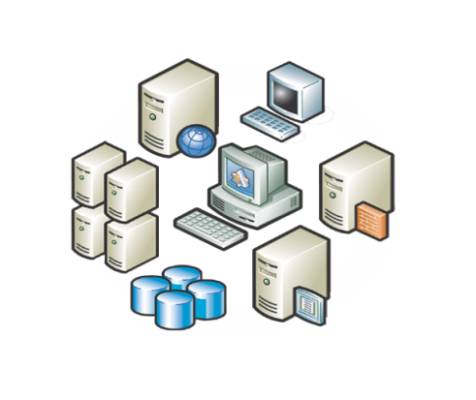

























Today’s Environment
High Speed networking
Clusters/Super Computers
Corporate Infrastructure
Storage
Engineers
Scientists
Financial Analysts
Information workers
Specialized languages
Compilers
Mainstream Technologies
Debuggers

Slide 6

The Challenge: High Productivity Computing
High integration pain
Lack of seamless integration between workstations, clusters, data
Lack of user workflow integration across applications and departments
Isolated technology islands
High manual touch
Lack of end-to-end IT process integration
Cannot leverage existing investments in broad IT skills and infrastructure
Application availability
Limited eco-system of parallel applications
Lack of developer-friendly tools, difficult to program
“Make high-end computing easier and more productive to use. Emphasis should be placed on time to solution, the major metric of value to high-end computing users… A common software environment for scientific computation encompassing desktop to high-end systems will enhance productivity gains by promoting ease of use and manageability of systems.”
High-End Computing Revitalization Task Force, 2004
(Office of Science and Technology Policy,
Executive Office of the President))

Slide 7
Why Microsoft in HPC?
Current Issues
HPC and IT data centers merging: isolated cluster management
Developers can’t easily program for parallelism
Users don’t have broad access to the increase in processing cores and data
How can Microsoft help?
Well positioned to mainstream integration of application parallelism
Have already begun to enable parallelism broadly to the developer community
Can expand the value of HPC by integrating productivity and management tools
Microsoft Investments in HPC
Comprehensive software portfolio: Client, Server, Management, Development, and Collaboration
Dedicated teams focused on Cluster Computing
Unified Parallel development through the Parallel Computing Initiative
Partnerships with the Technical Computing Institutes

Slide 8
High Productivity Computing
Combined Infrastructure
Integrated Desktop and HPC Environment
Unified Development Environment

Slide 9



Microsoft’s Productivity Vision for HPC
Windows HPC allows you to accomplish more, in less time, with reduced effort by leveraging users existing skills and integrating with the tools they are already using.
Administrator
Application Developer
End - User
Integrated Turnkey HPC Cluster Solution
Simplified Setup and Deployment
Built-In Diagnostics
Efficient Cluster Utilization
Integrates with IT Infrastructure and Policies
Integrated Tools for Parallel Programming
Highly Productive Parallel Programming Frameworks
Service-Oriented HPC Applications
Support for Key HPC Development Standards
Unix Application Migration
Seamless Integration with Workstation Applications
Integration with Existing Collaboration and Workflow Solutions
Secure Job Execution and Data Access

Slide 10
Integrated HPC of the Future

Slide 11



Windows HPC Server 2008
Complete, integrated platform for computational clustering
Built on top the proven Windows Server 2008 platform
Integrated development environment
Windows Server 2008 HPC Edition
Secure,
Reliable, Tested
Support for high performance hardware (x64, high-speed interconnects)
Microsoft HPC Pack 2008
Job Scheduler
Resource Manager
Cluster Management
Message Passing Interface
Microsoft Windows HPC Server 2008
Integrated Solution
out-of-the-box
Leverages investment in Windows administration and tools
Makes cluster operation easy and secure as a single system
  Evaluation available from http://www.microsoft.com/hpc

Slide 12

What’s New in the HPC Pack 2008
New System Center UI
PowerShell for CLI Management
High Availability for Head Nodes
Windows Deployment Services
Diagnostics/Reporting
Support for Operations Manager
Support for open standards
Granular resource scheduling
Improved scalability for larger clusters
New Job scheduling policies
Interoperability via HPC Profile
Systems Management
Job Scheduling
Networking
& MPI
Storage
NetworkDirect (RDMA) for MPI
Improved Network Configuration Wizard
Shared Memory MS-MPI for multi-core
MS-MPI integrated with Windows Event Tracing
Improved iSCSI SAN & parallel file system Support in Win2008
Improved Server Message Block ( SMB v2)
New 3rd party parallel file system support for Windows
New Memory Cache Vendors
Notes:
iSCSI

Slide 13


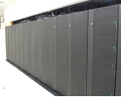
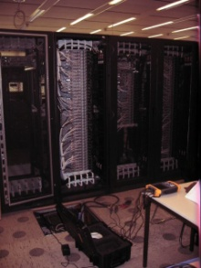
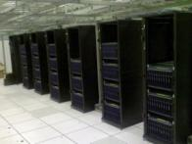
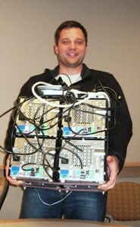

Spring 2008, NCSA, #23
9472 cores, 68.5 TF, 77.7%
Spring 2008, Umea, #40
5376 cores, 46 TF, 85.5%
Spring 2008, Aachen, #100
2096 cores, 18.8 TF, 76.5%
Fall 2007, Microsoft, #116
2048 cores, 11.8 TF, 77.1%
30% efficiency
improvement
Windows HPC Server 2008
Windows Compute Cluster 2003
Spring 2007, Microsoft, #106
2048 cores, 9 TF, 58.8%
Spring 2006, NCSA, #130
896 cores, 4.1 TF
Winter 2005, Microsoft
4 procs, 9.46 GFlops

Slide 14

Windows HPC Server 2008
Ready for Prime-time
#23
Summer
2008
Location | Champaign, IL
Hardware – Machines | Dell blade system with 1,200 PowerEdge 1955 dual-socket, quad-core Intel Xeon 2.3 GHz processors
Hardware – Networking | InfiniBand and GigE
Number of Compute Nodes | 1184
Total Number of Cores | 9,472 cores
Total Memory | 9.6 terabytes
Particulars of for current Linpack Runs
Best Linpack rating | 68.5 TFPs
Best cluster efficiency | 77.7%
For Comparison…
Linpack rating from November 2007 Top500 run (#14) on the same hardware | 68.5 TFPs
Cluster efficiency from November 2007 Top500 run (#XX) on the same hardware | 69.9%
Typical Top500 efficiency for Clovertown motherboards w/ IB regardless of Operating System | 65-77%
7.8% improvement in efficiency on the same hardware running Linux
About 4 hours to deploy

Slide 15
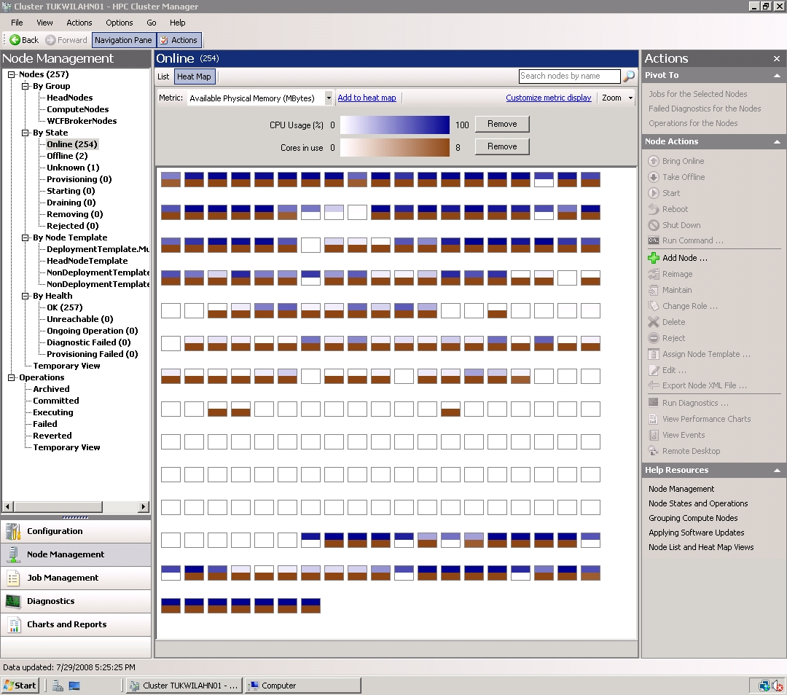
Improved Efficiency for the Systems Admin
Simple to setup and manage in a familiar environment
  Turnkey cluster solutions through OEMs
  Simplify system and application deployment
    Base images, patches, drivers, applications
Focus on ease of management
  Comprehensive diagnostics , troubleshooting and monitoring
  Familiar, flexible and “pivotal” management interface
  Equivalent command line support for unattended management
Scale up
  Scale deployment, administration, infrastructure
  Head node failover
  Cluster usage reporting
  Compute node filtering
Better integration with enterprise management
  Patch Management
  System Center Operations Management
  PowerShell
  Windows 2008 high Availability Services

Slide 16
System Center Operations Manager for HPC
A more productive HPC environment
Canned reports for end-user perspective monitoring
Security logs analysis and reporting
Scalable Monitoring
Monitor apps running in a scale out, distributed environment
Agent-less Monitoring
Increased Efficiency and Control
More secure by design
Integration with Active Directory
Extended solution with Management Packs
Scale using tiered management servers

Slide 17



Head Node High Availability
Eliminates single point of failure with support for high availability
Requires Windows Server 2008 Enterprise Failover Clustering Services
  Next generation of cluster services
  Major improvement in configuration validation and management
HPC Pack Includes
  Setup integration with Failover Clustering Services
    Head Node and Failover Node set up with SQL Failover Cluster
    Job Scheduler services failover
  Management console linked to Windows Server Failover Management console
Private Network
Windows
Failover
Clustered
Head node
Win2008 Enterprise
Clustered SQL Server
Failover Head node
Win2008 Enterprise
Clustered SQL Server
Shared Disk
Notes:
If a head node failure is detected, the shared disk will be dismounted from the head node and mounted for the failover server.
The job scheduler will be started on the failover server.
Existing jobs will continue to run uninterrupted on the compute nodes

Slide 18
NetworkDirect
A new RDMA networking interface built for speed and stability
Priorities
  Comparable with hardware-optimized MPI stacks
  Verbs-based design for close fit with native, high-perf networking interfaces
  Coordinated w/ Win Networking team’s long-term plans
Implementation
  MS-MPIv2 capable of 4 networking paths:
    Shared Memory
    between processors on a motherboard
    TCP/IP Stack (“normal” Ethernet)
    Winsock Direct (and SDP)
    for sockets-based RDMA
    New RDMA networking interface
  HPC team partners with networking IHVs to develop/distribute drivers for this new interface
Socket-Based App
MPI App
MS-MPI
Windows Sockets
(Winsock + WSD)
RDMA Networking
Networking Hardware
Networking Hardware
WinSock Direct Provider
Networking Hardware
Networking Hardware
TCP/Ethernet
Networking
NetworkDirect Provider
Networking Hardware
Networking Hardware
User Mode
User Mode Access Layer
TCP
Kernel Mode
IP
NDIS
Kernel By-Pass
Networking Hardware
Networking Hardware
Mini-port Driver
Networking Hardware
Networking Hardware
Hardware Driver
Networking Hardware
Networking Hardware
Networking Hardware
(ISV) App
CCP Component
OS Component
IHV Component

Slide 19
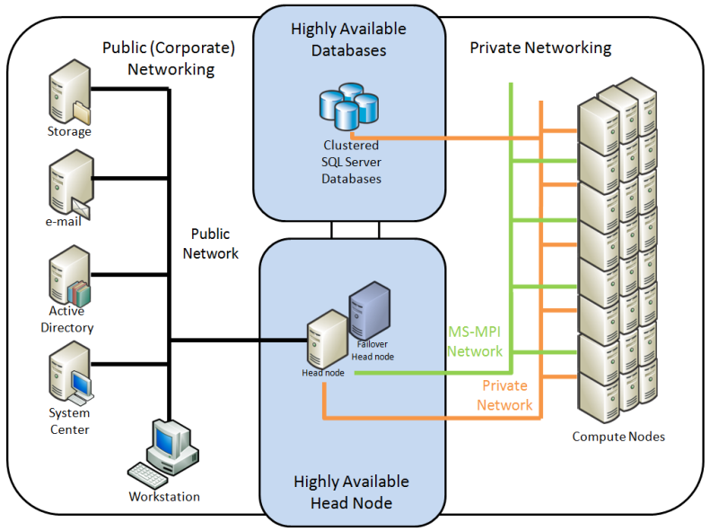
Job Scheduling
Support for larger clusters
  Create new designs for clusters of size, including
  “heterogeneous” clusters
  Scale deployment and administration technologies
  Provide interfaces for those accustomed to *nix
Improve interoperability with existing IT infrastructure
  Interoperability with existing job schedulers
  High speed file I/O through native support for parallel and clustered file systems
Broader application support
  Simplify the integration of new applications with the job scheduler
  Addressing needs of in-house and open source developers
Platform Support
  Built for Windows Server 2008
  Cluster nodes with different hardware / software

Slide 20
Scenario: Broaden Application Support
V1 (focusing on batch jobs)
V2 (focusing on Interactive jobs)
Engineering Applications
Structural Analysis Crash Simulation
Oil & Gas Applications
Reservoir simulation Seismic Processing
Life Science Applications
Structural Analysis Crash Simulation
Financial Services
Portfolio analysis Risk analysis Compliance Actual
Excel
Pricing Modeling
Interactive Cluster Applications
Your applications here
Job Scheduler
Resource allocation
Process Launching
Resource usage tracking
Integrated MPI execution
Integrated Security
WCF Service Router
WS Virtual Endpoint Reference
Request load balancing
Integrated Service activation
Service life time management
Integrated WCF Tracing
+
App.exe
App.exe
App.exe
App.exe
Service
(DLL)
Service
(DLL)
Service
(DLL)
Service
(DLL)

Slide 21





Service-Oriented Jobs
Public Network
Highly Available
Head Node
Private Network
Workstation
1. User submits job.
Failover Head node
Head node
3. HN Provides WCF Broker node
2. Session Manager assigns WCF Broker node for client job
5. Requests
Workstation
4. Client connects to Broker and submits requests
WCF
Brokers
7. Responses return to client
[…]
6. Responses
Compute Nodes
Workstation

Slide 22
Interoperability & Open Grid Forum
What is it?
A draft OGSA (Open Grid Services Architectures) interoperability standard for batch job scheduler task submission and management
Based on web services standards (HTTP, XML, SOAP)
What is its value?
Enables integration of HPC applications executing on different platforms and schedulers via web services standards
What’s the Status?
Passed the public comment period
Working on new extensions
LSF / PBS / SGE / Condor
Linux, AIX, Solaris
HPUX, Windows
Windows Cluster
Windows Center
Window Center

Slide 23
Parallel Programming
Parallel Program Tools
Compilers and Languages | Visual C++ Visual C# Visual Basic Visual F# | Intel C++ Intel Fortran PGI C++ PGI Fortran
Debuggers | WinDbg VS Debugger (MC & MPI) Allinea Visual Studio plug-in (MPI) MPI/Event Tracing for Windows PGI MPI Debugger
Profilers | Visual Studio Profiler Vtune Code Analyst | MPI/Event Tracing for Windows PGI MPI Profiler
Analyzers | Marmot MPI/Event Tracing for Windows Vampir | Intel Trace Collector/Analyzer Intel Thread Checker Utah U MPI model checker
Parallel Programming Models | OpenMP MPI (MS, Intel, HP MPI Libs) MPI.NET MPI.C++ | PFx: Tark Paralell Library PFx: Parallel LINQ SOA on Cluster Intel Thread Building Blocks
Math Libraries | Intel MKL AMD IMSL Visual Numerics | NAG Other OSS mathlibs
Available Now
  Development and Parallel debugging in Visual Studio
  3rd party Compilers, Debuggers, Runtimes etc.. available
Emerging Technologies – Parallel Extensions to .NET Framework
  LINQ/PLINQ – natural OO language for SQL queries in .NET
  Task Parallel libraries
  currently CTP June ‘08

Slide 24
Version Comparison
Feature | Windows Compute Cluster Server 2003 | Windows HPC Server 2008
Operating system | Windows Server 2003 SP1 | Windows Server 2008 HPC Edition, Standard, Enterprise, Datacenter
Processor Type | X64 (AMD64 or Intel EM64T) | X64 (AMD64 or Intel EM64T)
Memory | 32 GB (Compute Cluster Edition) | 128 GB (HPC Edition)
Node Deployment | Remote Installation Services(RIS) | Windows Deployment Services
Head Node Availability | N/A | Windows Failover Clustering and SQL Server Failover Clustering
Management | Basic node and job management | Integrated node and job management, grouping, monitoring at-a-glance, diagnostics
Network Topology | Network Configuration Wizard | Improved Network Configuration Wizard
MS-MPI | Winsock Direct-based | Network Direct-based. New shared memory implementation for multicore processors
Scheduler | Command line or GUI | Integrated in management console, with full support for Windows PowerShell scripting and legacy command-line UI scripts from v1. Greatly improved speed and scalability
Programmability | Support for Batch or MPI based jobs | Added support for interactive Service Oriented Applications (SOA) using the Windows Communication Foundation (WCF)
Reporting | N/A | Integrated into Management console
Monitoring | Rely on Windows. No cluster specific support. | Heat map on cluster or node group. Per node charts. Cluster-wide performance overview
Diagnostics | N/A | In the box verification tests and performance tests. Store, filter, and view test results and history

Slide 25



HPC Storage Solutions
NAS and Clustered NAS
Shared File Systems or SAN file systems
Parallel File Systems
Greater
Sophistication
Aggregate (Mb/s/core)
IBM – GPFS
Panasas – Active Scale
SUN - Lustre
HP - PolyServe
Ibrix - Fusion
Quantum - StorNext
SANbolic – Melio file system
Windows Server 2003
Windows Server 2008
…
Number of cores in cluster

Slide 26

High Speed Networking Technologies
Cisco
Voltaire
Qlogic
Open Fabrics
Myrinet, Infiniband, 10GigE
NetEffect
Bandwidth
Myricom
1Gig Ethernet
100MB Ethernet
Availability

Slide 27


Industry Focused Partners

Slide 28
Resources
Microsoft HPC Web site: Evaluate Today
  http://www.microsoft.com/hpc
Windows HPC Community site
  http://www.windowshpc.net
Windows HPC Techcenter
  http://technet.microsoft.com/en-us/hpc/default.aspx
HPC on MSDN
  http://code.msdn.microsoft.com/hpc
Windows Server Compare website
  http://www.microsoft.com/windowsserver/compare/default.mspx
HPC in USA: Lynn Lewis - lynnlew@microsoft.com
Notes:
<Presenter Notes>

Slide 29

© 2008 Microsoft Corporation. All rights reserved.
This presentation is for informational purposes only. Microsoft makes no warranties, express or implied, in this summary.

